Slide 1

Program Name
Weekly Program Status
Weekly Update Summary
Intent to cover update for larger projects with multiple sub-projects high level information that affects the overall timeline or implementation
Issue | Date to Resolve | Remediation Plan
 |  | Intent to cover issues the are or could Prohibit Progress across multiple projects or need escalation/decision (by Project Steering Committee or Director level)

Slide 2
Project Name – SD Project Number
Weekly Project Status
Project Manager: Accountable for project timeline and status
Functional Area: Business Functional Area
Start Date: IT Approval
Implementation: Go Live
Forecasted Start Date:
Forecasted Imp:
% complete:
Schedule
Scope
Resources
Danger
On Track
Ahead
Danger
On Track
Ahead
Danger
On Track
Ahead
Weekly Update
Current Week Summary:
Current Week Task Progress:
Next Week Scheduled Tasks:
Rolling update for Month of xxxx:
Issue | Date to Resolve | Remediation Plan
 |  | Intent to cover issues the are or could Prohibit Progress or need escalation/decision (by Project Steering Committee or Director level)

Slide 3
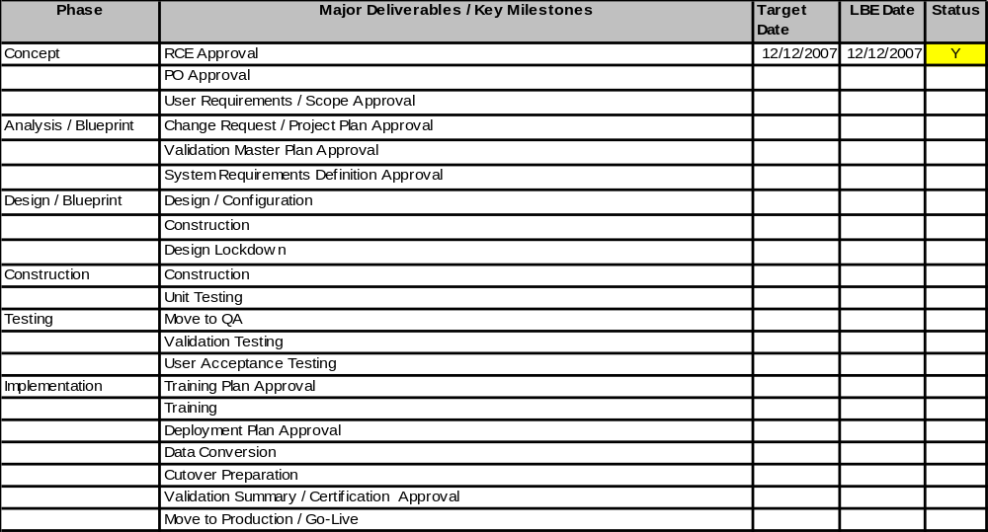
Project Name – SD Project Number
Weekly Project Status
enter Y for Yellow = probable that Target will be missed
enter R for Red = confident that Target will be missed or has been missed
enter G for Green = confident that target will be met
enter C for Complete

